Slide 1
ISO/TC211 AHG UML Best practices - Report to Plenary
Knut Jetlund, Convenor

Slide 2
Meetings and other activity
Meeting in Southampton Tuesday afternoon
22 participants.
Great deal of interest from the Geospatial community, even more outside ISO/TC211 than inside.
Many stakeholders are working on domain models and product specifications, and feel the need for guidance on UML.
Attended the EuroSDR/OGC workshop in Copenhagen in January:Data Modelling and Model Driven Implementation of Data Distribution.
A lot of positive feedback from participants from European countries, JRC, OGC and more.

Slide 3
GitHub and LiveLink
LiveLink - ISO/TC 211/AHG 02 "Best practices for UML modelling"
For official documents
GitHub - https://github.com/ISO-TC211/UML-Best-Practices
For the practical work
Why GitHub?
Wiki
Tracking changes
Tracking issues: Milestones, labels, assignees, discussions
Open for a wider community

Slide 4
https://github.com/ISO-TC211/UML-Best-Practices
GitHub
https://github.com/ISO-TC211/UML-Best-Practices
For reference documents, scripts, illustrations etc.
https://github.com/ISO-TC211/UML-Best-Practices/wiki
Wiki for UML Best practices
https://github.com/ISO-TC211/UML-Best-Practices/issues
For issue tracking

Slide 5
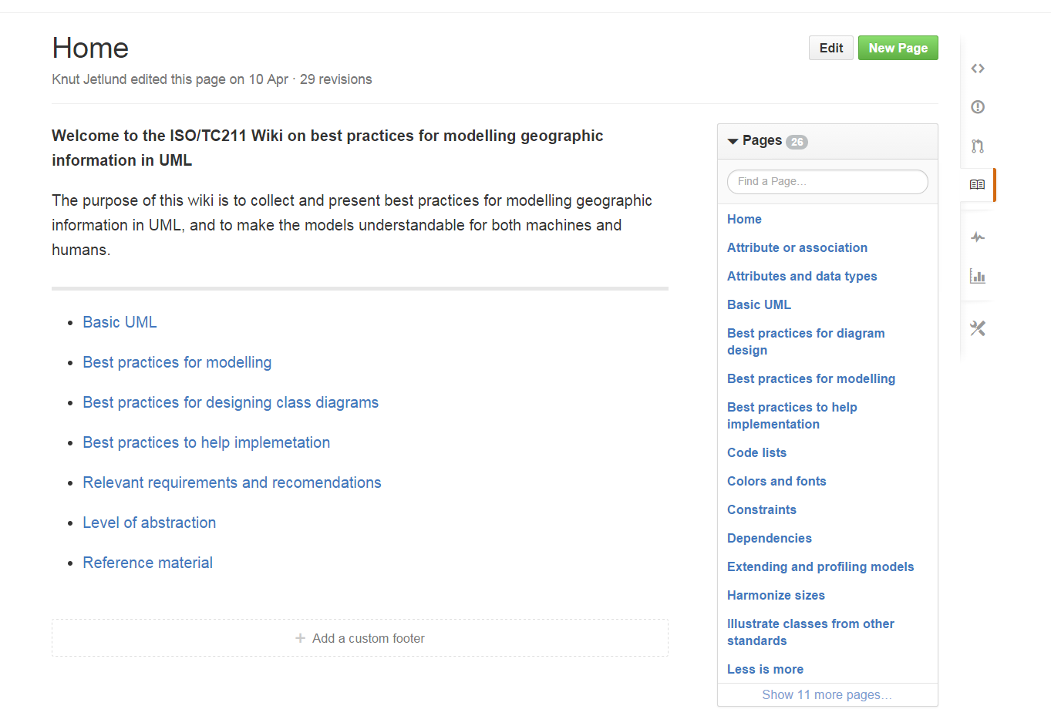
https://github.com/ISO-TC211/UML-Best-Practices/wiki

Slide 6
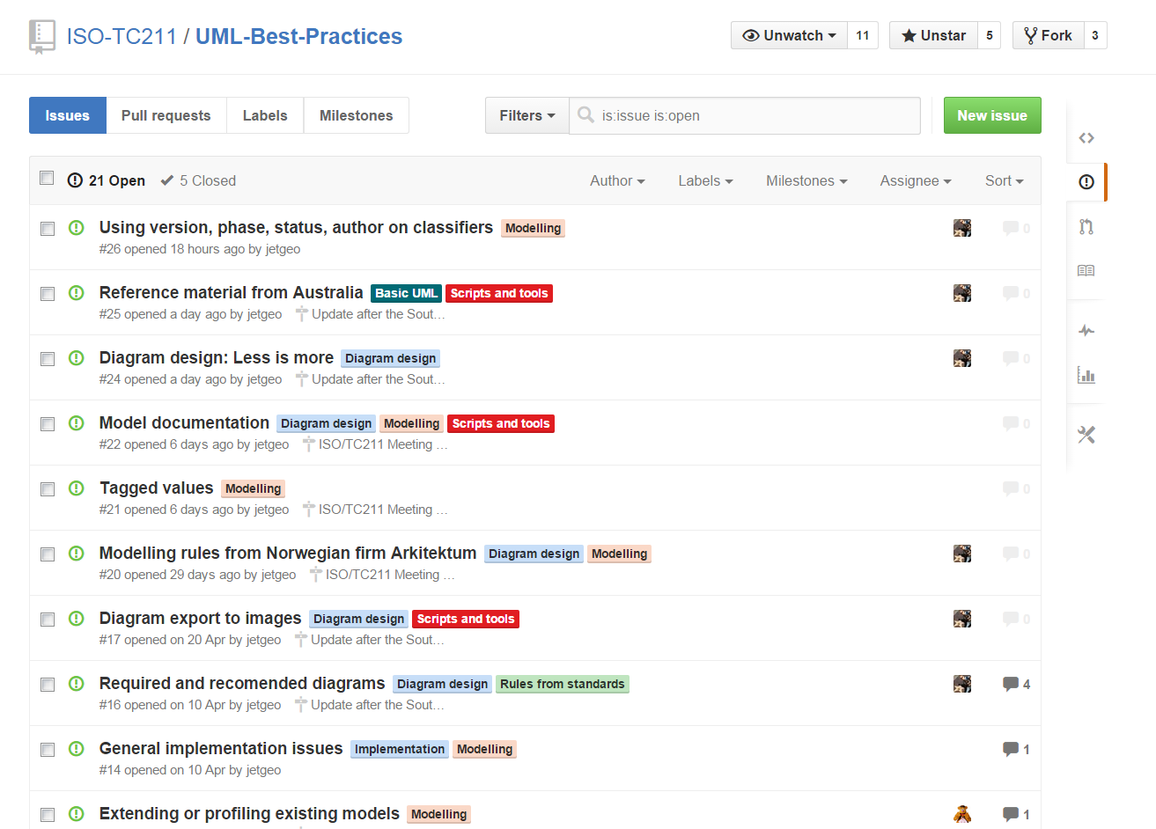
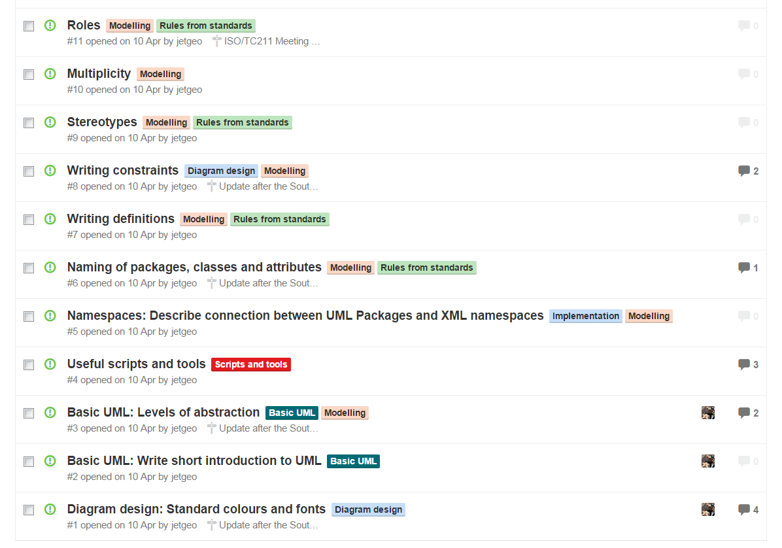
https://github.com/ISO-TC211/UML-Best-Practices/issues

Slide 7
Status
Much work done on diagram design
Several new issues raised at AHG Meeting
Some work done on modelling
Several issues registered
Several new issues raised at the AHG Meeting
Some work done on scripts and tools
Scripts in VBScript, JScript, searches (XML)
Several contributors have scripts that will be uploaded
Some work done on basic UML
Relevant requirements and recomendations
Levels of abstraction
Several issues registred
Much left to do on implementation issues
Several issues registered

Slide 8
Revised action plan
Continue at least up to the next plenary (dec 2015)
Maybe longer
Adopt into the HMMG in the future
Wiki to be moved to official ISO/TC211 Wiki in the future

